Slide 1
Sneaker Classification Meeting 2
By: Shahan Rahman, Hasibul Islam, Jun Zheng & Carlos Vides

Slide 2
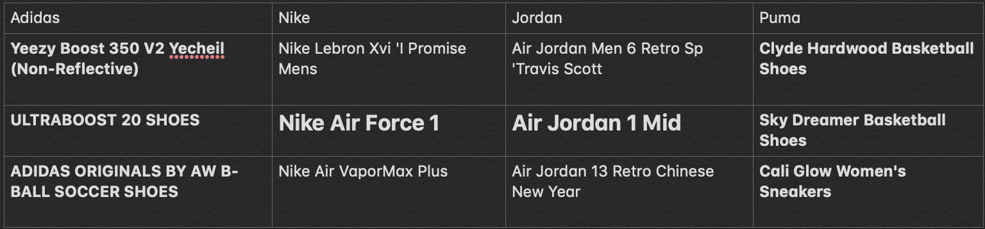
Gathering Data
Our group decided having four sneaker companies. With 3 sneakers each, we made the choice to have one for each gender and one neutral.
Notes:
Gathering Data

Slide 3
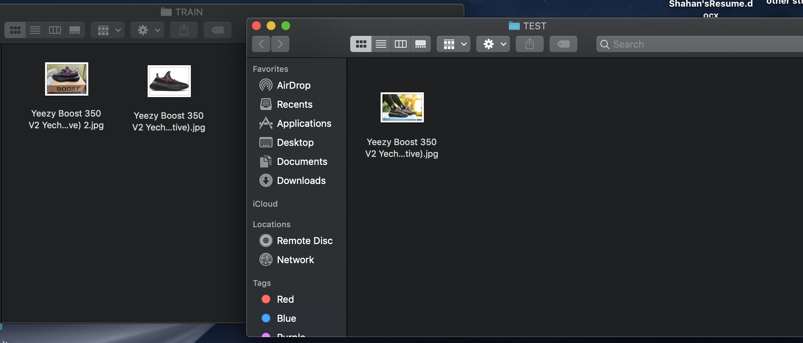
Data Pre-Processing
Our team decided to have 80 percent of the sneaker images be classified and have names of the shoe as file names. The rest of the 20 percent will be similar sneakers that have no file name corresponding to the actual shoe.
Notes:
Data Pre-Processing (Cleaning Data, 80/20 Rule)

Slide 4
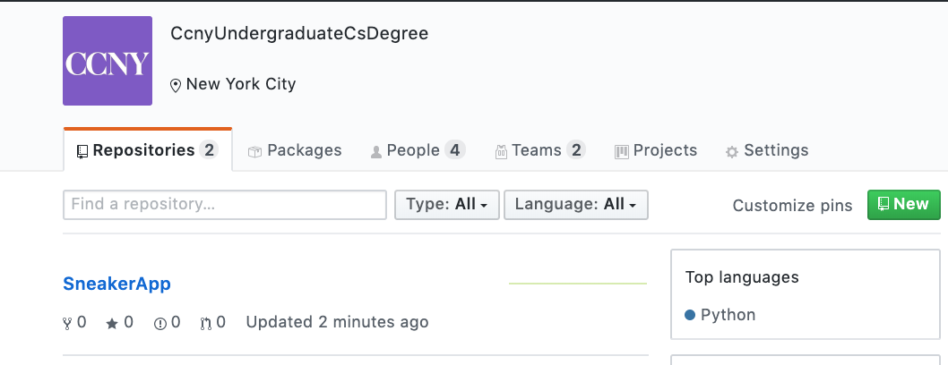
Github Setup
Our project will be on google's cloud and just incase on github for local backups on every group members computer.
Notes:
Open up a github workflow environment for the team

Slide 5
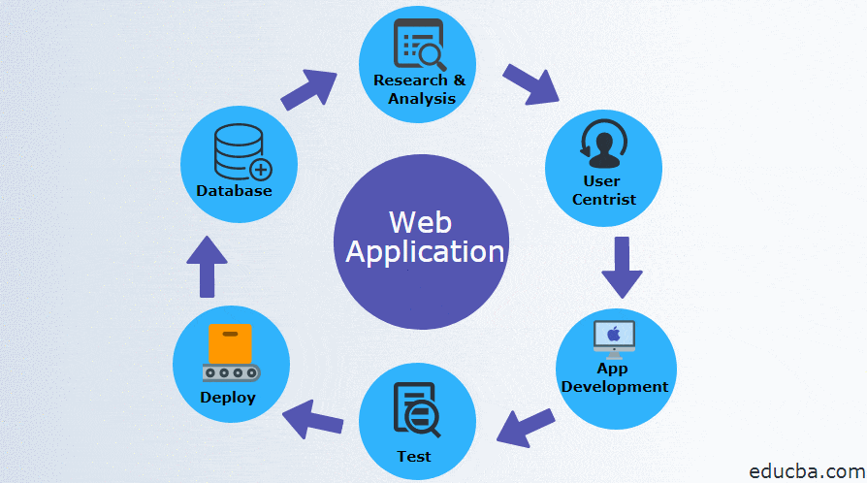
Platform of Choice
Our platform choice is to make a web application.
Working ON!
IOS APP
Notes:
Decide whether it would be a mobile or a web application
platform of choice

Slide 6
Workloads
Shahan Rahman - Project Manager & Full Stack Engineer
Hasibul Islam - Frontend Engineer & QA Tester
Jun Zheng - Backend Engineer
Carlos Vides - Backend Engineer & QA Tester
Notes:
Sort out the workload between all 4 members

Slide 7
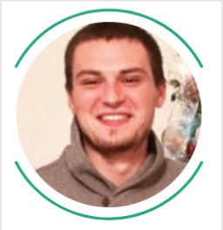
Summary Of Similar Projects
Connor Shorten
100 Days of ML Code
140 images in his dataset
91% accuracy using a 4-layer convolutional network.
Sentdex
Notes:
https://towardsdatascience.com/how-to-build-a-convolutional-network-classifier-81eef880715e][
Connor Shorten created for 100 Days of ML Code. His project was to build an image classifier that would distinguish between Nike and Adidas basketball shoes. He only used 140 images in his dataset. He was able to achieve 91% accuracy using a 4-layer convolutional network. He also used tutorial from sentdex that used tensorflow learn api to build image recognition models. His source code can also be found on his github.

Slide 8
Our Take Away
Pros | Cons
Shows us how to build a convolutional network. | Not specific shoes of photos
Has tutorials to support his work | No GUI
Uses tensorflow | Scope of brands are only two

Slide 9
What we plan to do between today and next meeting?
Begin development and load data into python script.
Finalize on sneaker catalog and have all images needed.
Decided how big should our database should be
Everyone individual roles starts which will result in every person having a slide that represents there progress with their roles.

Slide 10
Thank YOU!

